Slide 1
Section 5.2: LAN Switches
Upon completion of this section, you should be able to:
Explain how a switch operates.
Explain how a switch builds its MAC address table and forwards frames.
Describe switch forwarding methods.
Describe the types of port settings available for Layer 2 switches.
Notes:
5.2

Slide 2
Topic 5.2.1: MAC Address Table

Slide 3
Switch Fundamentals
An Ethernet Switch is a Layer 2 device.
It uses MAC addresses to make forwarding decisions.
The MAC address table is sometimes referred to as a content addressable memory (CAM) table.
Notes:
5.2.1.1 Switch Fundamentals

Slide 4
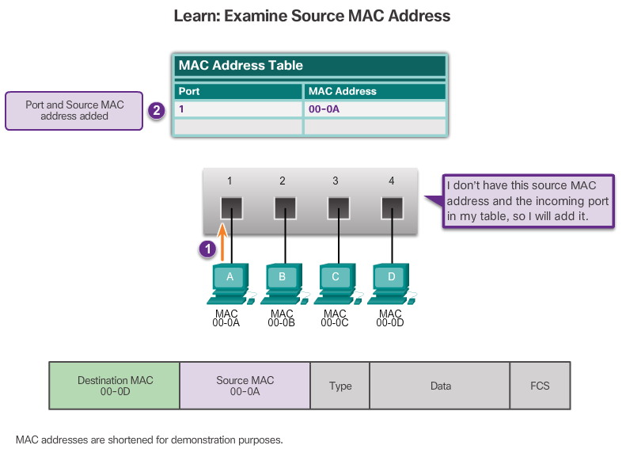
Learning MAC Addresses
Notes:
5.2.1.2 Learning MAC Addresses

Slide 5
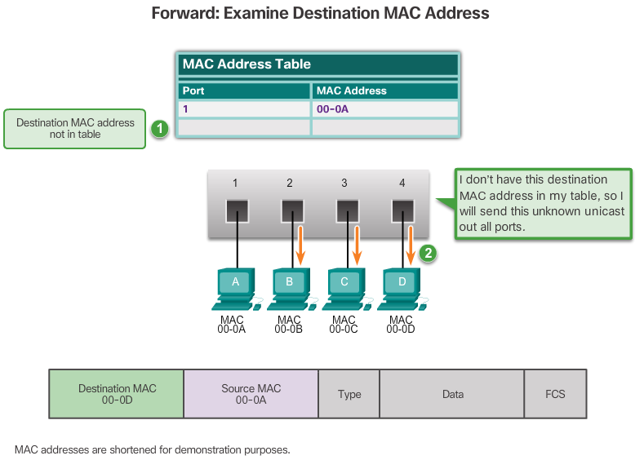
Learning MAC Addresses (cont.)
Notes:
5.2.1.2 Learning MAC Addresses (Cont.)

Slide 6
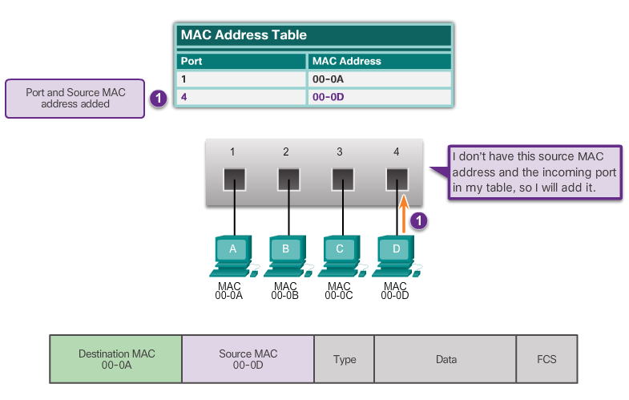
Filtering Frames
PC-D sends a frame back to PC-A and the switch learns PC-D’s MAC address.
Notes:
5.2.1.3 Filtering Frames

Slide 7
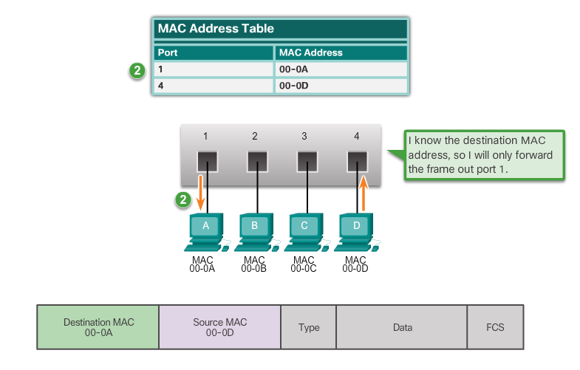
Filtering Frames (cont.)
Since the Switch MAC Address table contains PC-A’s MAC Address, it sends the frame out only port 1.
Notes:
5.2.1.3 Filtering Frames (Cont.)

Slide 8
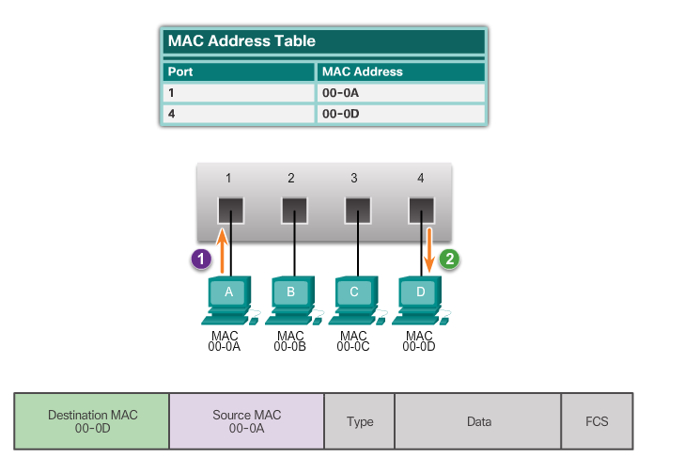
Filtering Frames (cont.)
PC-A sends another frame to PC-D. The switch’s table now contains PC-D’s MAC address, so it sends the frame out only port 4.
Notes:
5.2.1.3 Filtering Frames (Cont.)

Slide 9
Video Demonstration - MAC Address Tables on Connected Switches
A switch can have multiple MAC addresses associated with a single port.
This occurs when the switch is connected to another switch.
See VIDEO DEMONSTRATION
Notes:
5.2.1.4 Video Demonstration - MAC Address Tables on Connected Switches

Slide 10
Video Demonstration - Sending a Frame to the Default Gateway
When a device has an IP address that is on a remote network, the Ethernet frame cannot be sent directly to the destination device.
The Ethernet frame is sent to the MAC address of the default gateway, which is the router.
See VIDEO DEMONSTRATION
Notes:
5.2.1.5 Video Demonstration - Sending a Frame to the Default Gateway
5.2.1.6 Activity - Switch It!
5.2.1.7 Lab – Viewing the Switch MAC Address Table

Slide 11
Topic 5.2.2: Switch Forwarding Methods

Slide 12
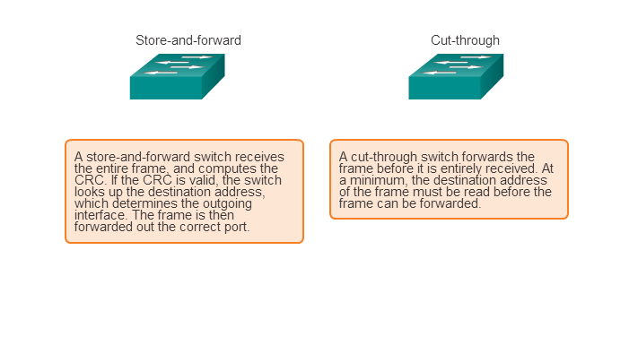
Frame Forwarding Methods on Cisco Switches
Notes:
5.2.2.1 Frame Forwarding Methods on Cisco Switches

Slide 13
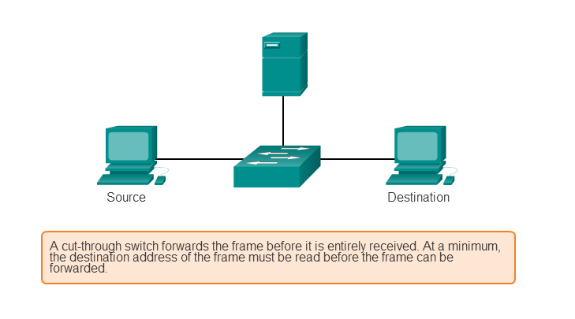
Cut-Through Switching
Fast-forward switching:
Lowest level of latency immediately forwards a packet after reading the destination address.
Typical cut-through method of switching.
Fragment-free switching:
Switch stores the first 64 bytes of the frame before forwarding.
Most network errors and collisions occur during the first 64 bytes.
Notes:
5.2.2.2 Cut-Through Switching

Slide 14
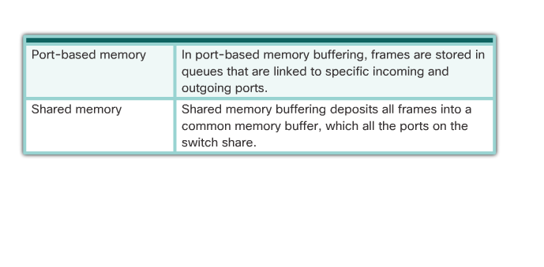
Memory Buffering on Switches
Notes:
5.2.2.3 Memory Buffering on Switches
5.2.2.4 Activity – Frame Forwarding Methods

Slide 15
Topic 5.2.3: Switch Port Settings

Slide 16
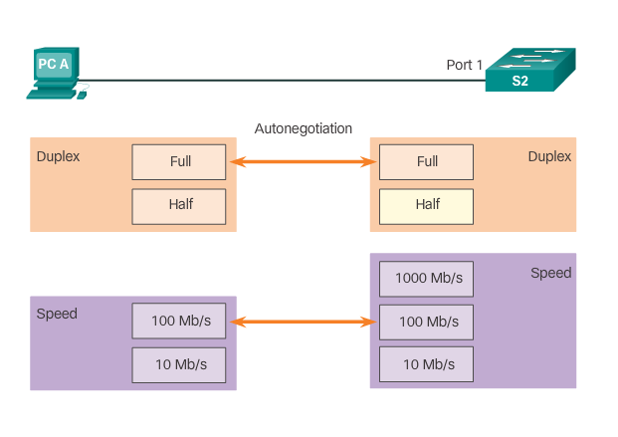
Duplex and Speed Settings
Full-duplex – Both ends of the connection can send and receive simultaneously.
Half-duplex – Only one end of the connection can send at a time.
Notes:
5.2.3.1 Duplex and Speed Settings

Slide 17
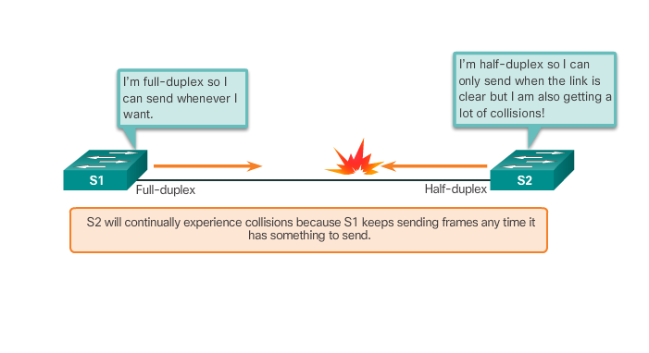
Duplex and Speed Settings (cont.)
A common cause of performance issues on 10/100 Mb/s Ethernet links is when one port on the link operates at half-duplex and the other on full-duplex.
Notes:
5.2.3.1 Duplex and Speed Settings (Cont.)

Slide 18
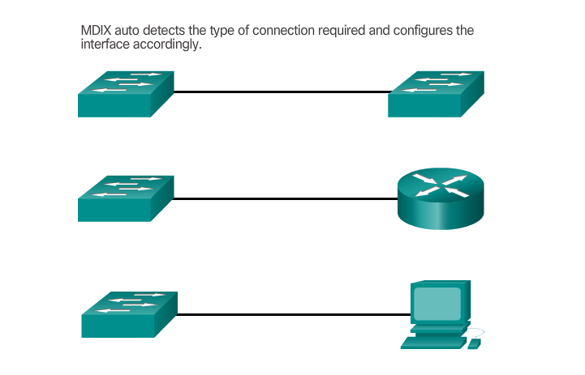
Auto-MDIX
Notes:
5.2.3.2 Auto-MDIX

